Slide 1


Visual Grounded Open-Vocabulary Object Pose Estimation
Chair of Computer Aided Medical Procedures TUM School of Computation, Information and Technology
Technical University of Munich
Advanced Topic in 3D Computer Vision (SS25)
Haoliang Huang, Yung Jhang Hou, Namozjon Ostonaev
School of Computation, Information and Technology
Technical University of Munich
Munich, 24. July 2025
Notes:
Give an explanation of what 6D pose is! For example, let me explain about what is object pose here. It is the 6D pose of object relative to the camera pose. when the camera changes, the pose also change.

Slide 2
Outline
Pipeline evolution: initial plan vs. real-world constraints
RGB→RGB-D conversion
Generation models: replacing the mesh input
Evaluation: comparing generated meshes
Future work
References
Notes:
Less time! Give a quick overview.

Slide 3

Motivation

Slide 4
Motivation
Can we estimate depth, reconstruct a 3D mesh, and recover 6D object pose — all from a single RGB image?

Slide 5
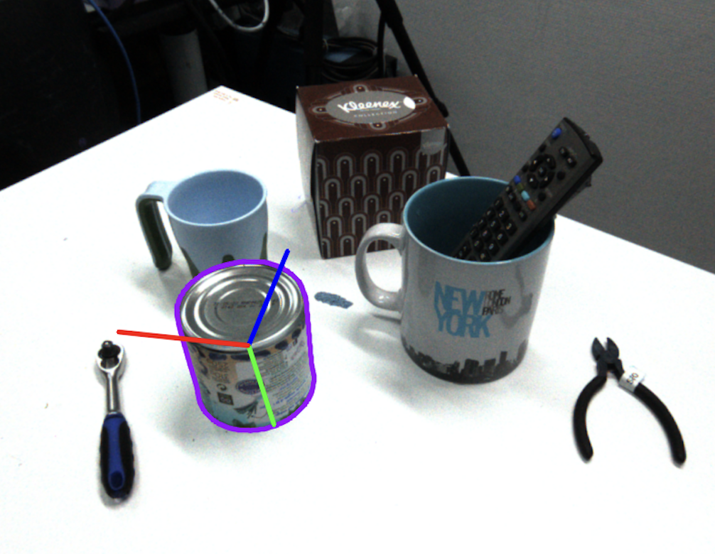
6D Object Pose
The camera is the origin of the coordinate system (0, 0, 0), facing along the Z-axis.
The 6D pose of an object tells:
Where the object is (translation: X, Y, Z)
How it’s rotated (rotation: α, β, γ or roll, pitch, yaw)
6D Pose = 3D Position (X, Y, Z) + 3D Rotation (α, β, γ)

Slide 6
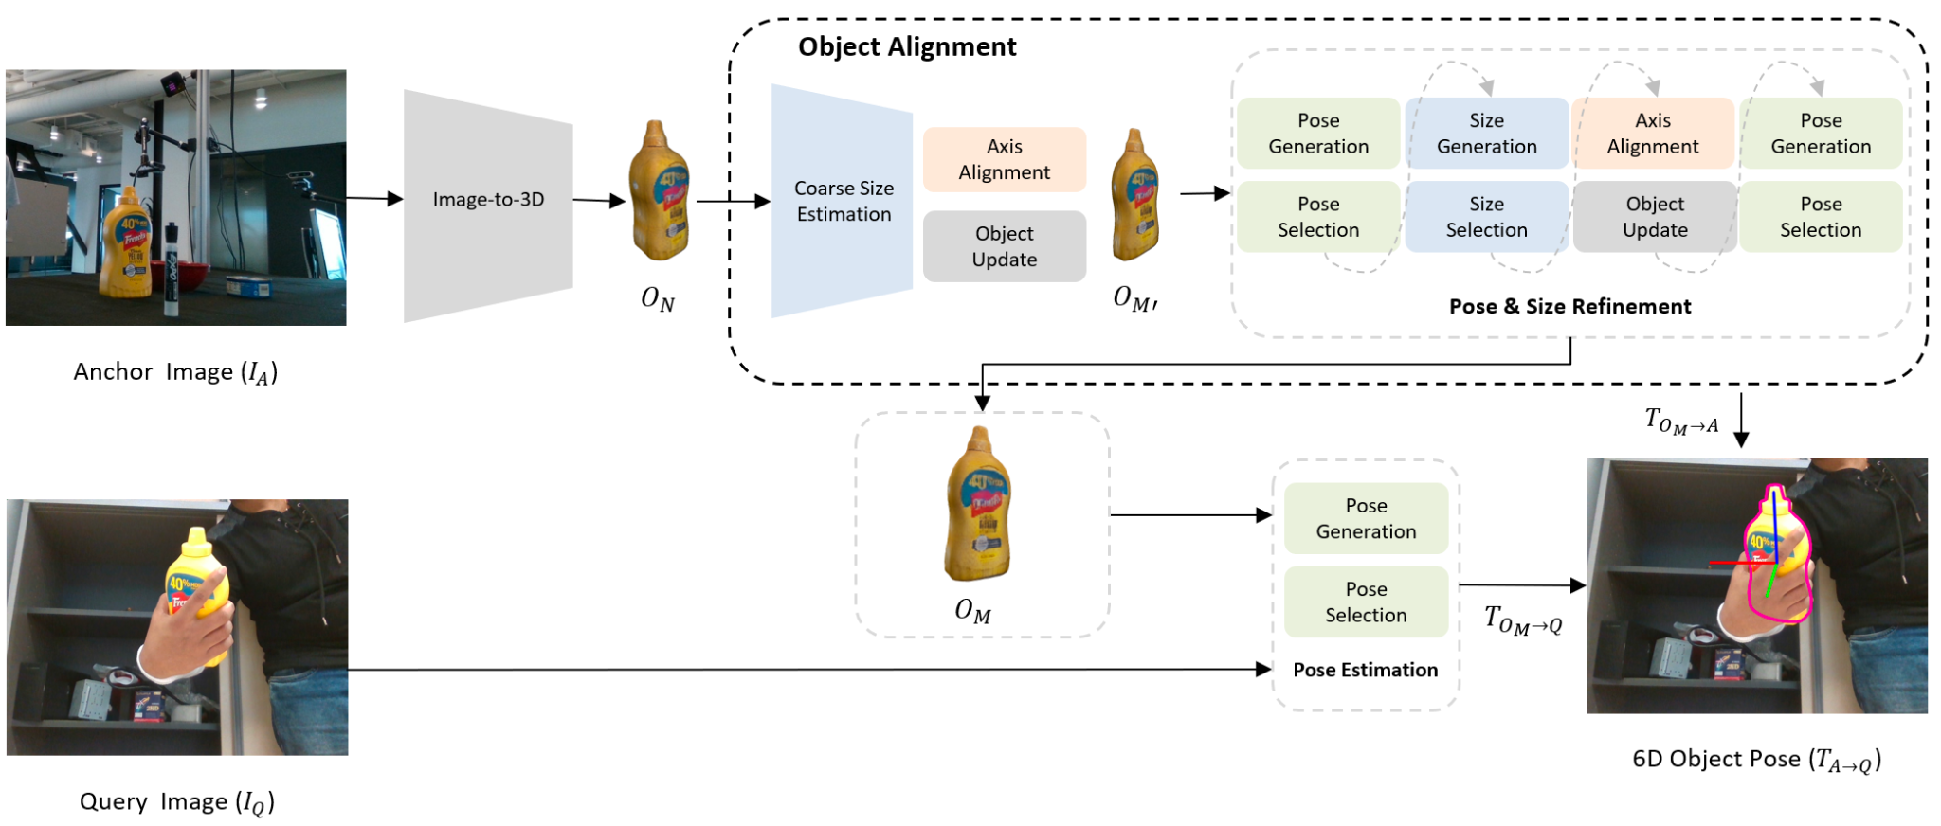
Initial Pipeline (Any6D)
Figure. Overview of the Any6D framework for model-free object pose estimation.
Lee, Taeyeop and Wen, Bowen and Kang, Minjun and Kang, Gyuree and Kweon, In So and Yoon, Kuk-Jin. {Any6D}: Model-free 6D Pose Estimation of Novel Objects, In Proceedings of the IEEE/CVF international conference on computer vision,2025
Notes:
Explain briefly of the pipeline. How does the process go in Any6D

Slide 7
Mesh Generation of Any6D
InstantMesh
Zero123++
Figure. Explanation of what is behind the generation model of Any6D.
Lee, Taeyeop and Wen, Bowen and Kang, Minjun and Kang, Gyuree and Kweon, In So and Yoon, Kuk-Jin. {Any6D}: Model-free 6D Pose Estimation of Novel Objects, In Proceedings of the IEEE/CVF international conference on computer vision,2025.
Yu, Xiaoxu and Liu, Jin and He, Bo and Xu, Yan and Chen, Xiaolong and Zeng, Bing and Li, Xin. {InstantMesh}: Efficient 3D Gaussian Splatting via Instant Content-Aware Meshing. In Proceedings of the IEEE/CVF Conference on Computer Vision and Pattern Recognition (CVPR), 2024.
Li, Ruohan and Chen, Xiang and Han, Jiaming and Li, Jiawei and Tang, Fang and Zhang, Fan and Yin, Ruoyu and Liu, Khawla and Xia, Hao. {Zero123++}: A Single-Image to 3D Model Generator. arXiv preprint arXiv:2311.16450, 2023.
Notes:
Zero123++ is multi view gen model
InstantMesh uses multiviews to makes up mesh

Slide 8
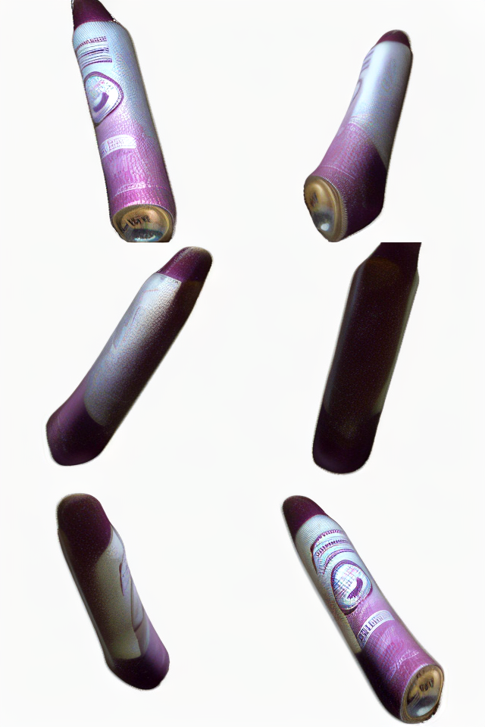
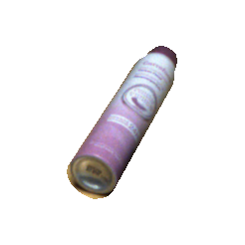
Problems!
Mesh generation was not good enough
RGB-D image was required
Figure. input target and distorted multiview generation

Slide 9
Updated Pipeline
Replace the generation model
Depth estimation
Figure. Overview of the Any6D framework for model-free object pose estimation.
Lee, Taeyeop and Wen, Bowen and Kang, Minjun and Kang, Gyuree and Kweon, In So and Yoon, Kuk-Jin. {Any6D}: Model-free 6D Pose Estimation of Novel Objects, In Proceedings of the IEEE/CVF international conference on computer vision,2025

Slide 10
Updated Pipeline (simplified)
Mesh generation
RGB image
Any6D (partial)
6D Pose
Depth estimation

Slide 11
Experiments

Slide 12
Experiments
Depth estimation
Preprocessing
Multiview Generation Models
Single Image to 3D Generation Models
Evaluation Metrics
Notes:
Less time. Briefly explain!

Slide 13
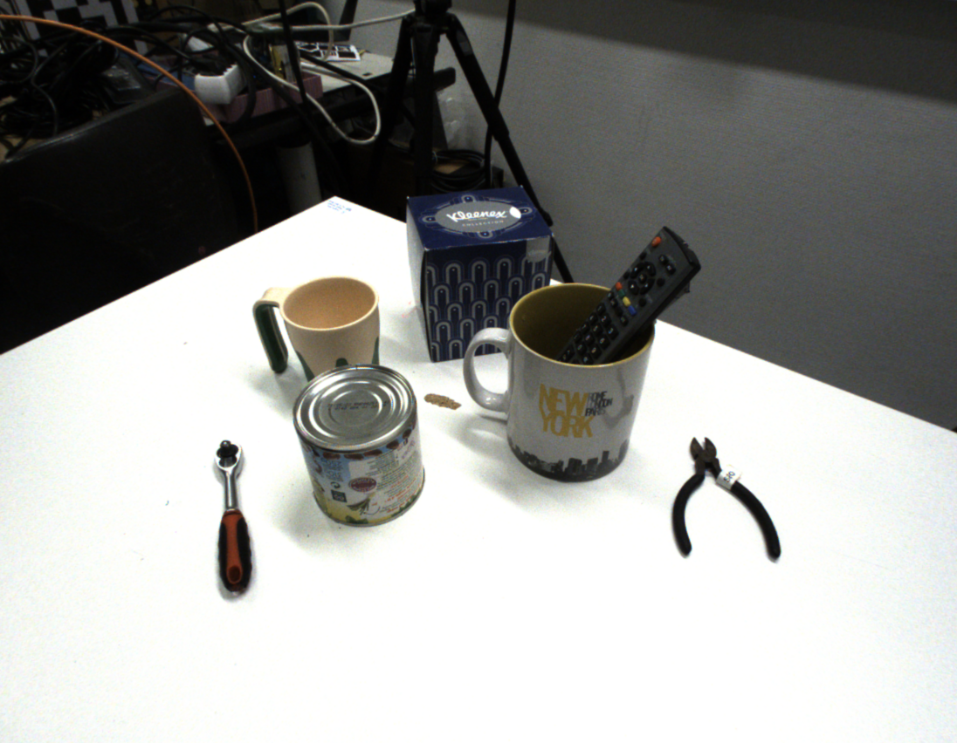
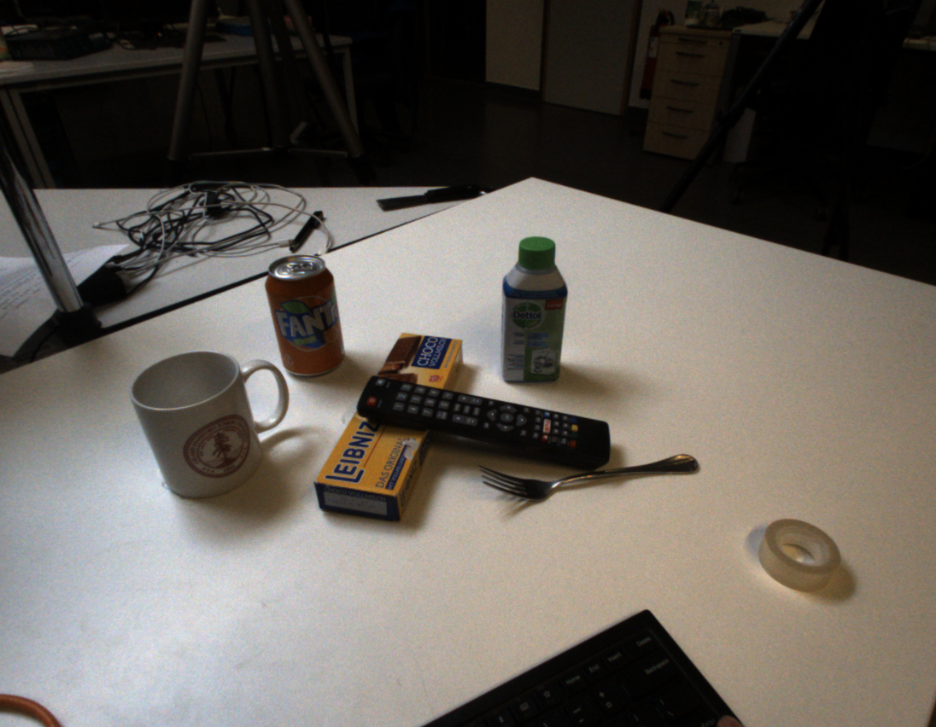
Dataset: HouseCat6D
Indoor images, including 10 scenes, shoots from several angles for each scene
Segmentation masks
Depth maps
Camera poses
Object poses
Notes:
Less time. Briefly explain!

Slide 14
Depth Estimation

Slide 15
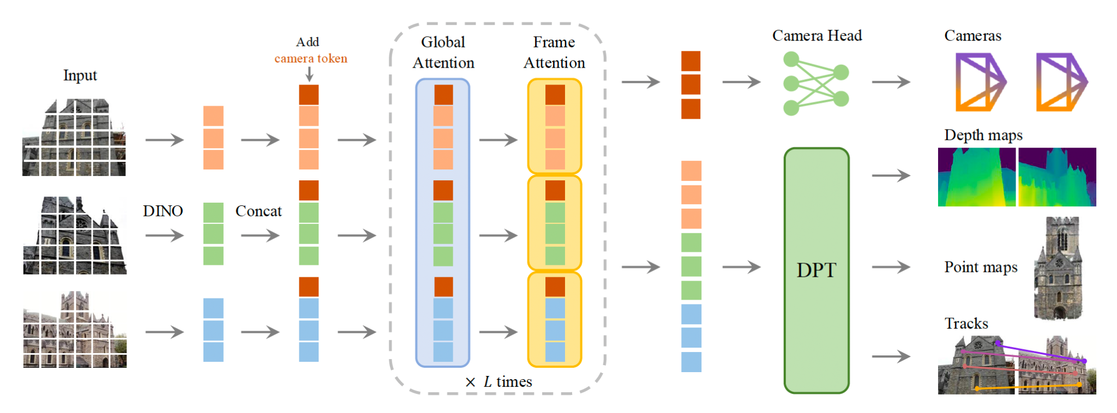
VGGT: Visual Geometry Grounded Transformer
Figure. VGGT Architecture Overview.
Wang, Jianyuan, et al. "VGGT: Visual Geometry Grounded Transformer." Proceedings of the IEEE/CVF Conference on Computer Vision and Pattern Recognition, 2025. arXiv.org, arxiv.org/abs/2503.11651

Slide 16
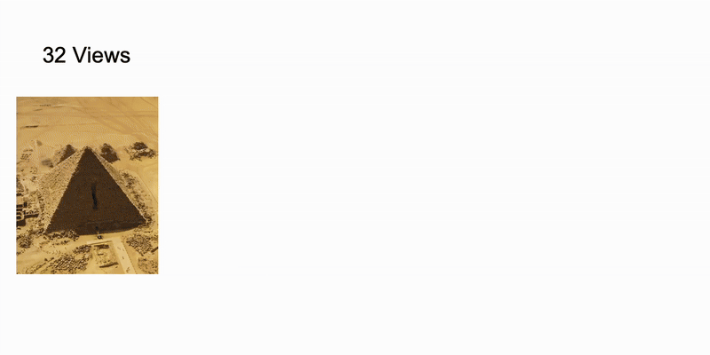
VGGT: Results from the paper
Figure 3. Reconstruction of the Egyptian pyramid with VGGT
Wang, Jianyuan, et al. "VGGT: Visual Geometry Grounded Transformer." Proceedings of the IEEE/CVF Conference on Computer Vision and Pattern Recognition, 2025. arXiv.org, arxiv.org/abs/2503.11651

Slide 17
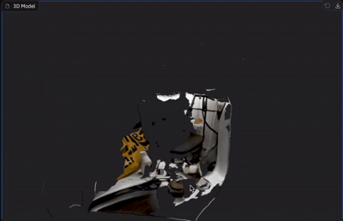
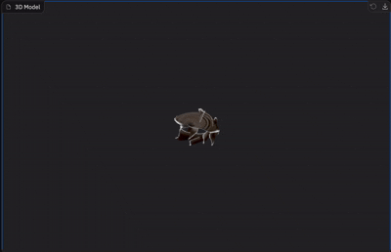
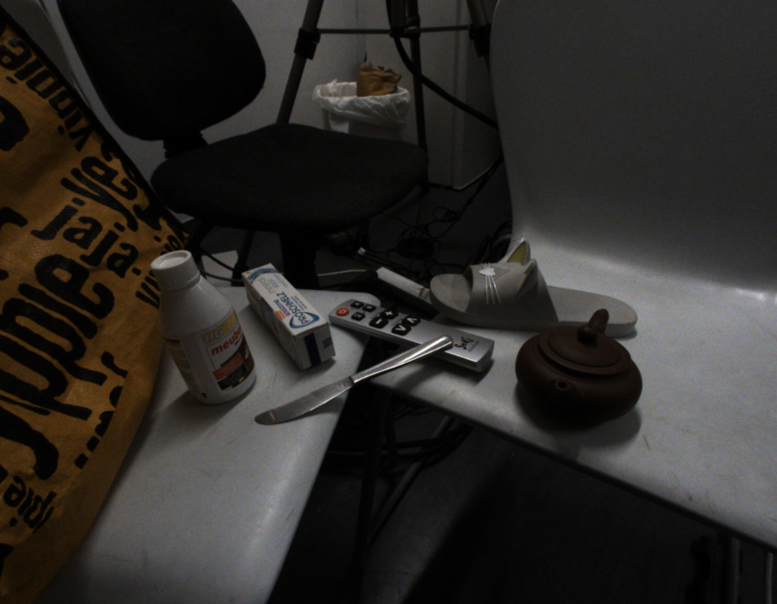
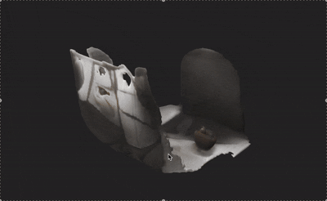
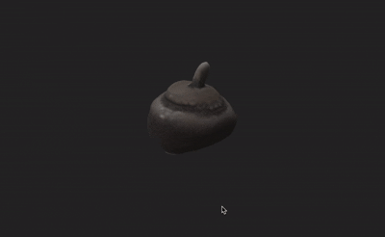
VGGT: Results from housecat6D
Target Image
VGGT
Figure. Given a target image from housecat6D dataset, 6 images are generated by Zero123++. Here are the results of VGGT point cloud, and InstantMesh mesh, both reconstructed from these 6 images.
InstantMesh
Wang, Jianyuan, et al. "VGGT: Visual Geometry Grounded Transformer." Proceedings of the IEEE/CVF Conference on Computer Vision and Pattern Recognition, 2025. arXiv.org, arxiv.org/abs/2503.11651
Yu, Xiaoxu and Liu, Jin and He, Bo and Xu, Yan and Chen, Xiaolong and Zeng, Bing and Li, Xin. {InstantMesh}: Efficient 3D Gaussian Splatting via Instant Content-Aware Meshing. In Proceedings of the IEEE/CVF Conference on Computer Vision and Pattern Recognition (CVPR), 2024.
Li, Ruohan and Chen, Xiang and Han, Jiaming and Li, Jiawei and Tang, Fang and Zhang, Fan and Yin, Ruoyu and Liu, Khawla and Xia, Hao. {Zero123++}: A Single-Image to 3D Model Generator. arXiv preprint arXiv:2311.16450, 2023.

Slide 18
VGGT: Visual Geometry Grounded Transformer
Figure. VGGT Architecture Overview.
Wang, Jianyuan, et al. "VGGT: Visual Geometry Grounded Transformer." Proceedings of the IEEE/CVF Conference on Computer Vision and Pattern Recognition, 2025. arXiv.org, arxiv.org/abs/2503.11651

Slide 19
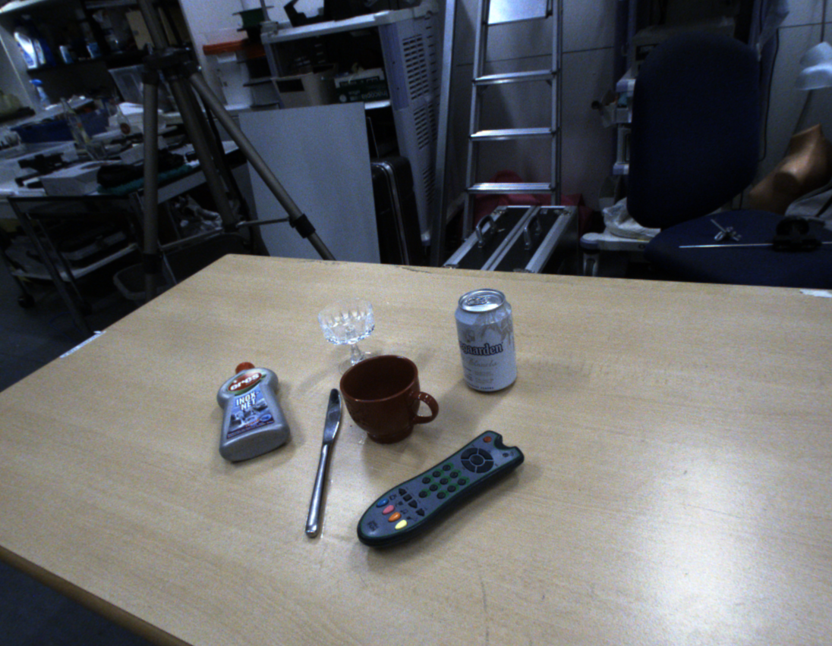
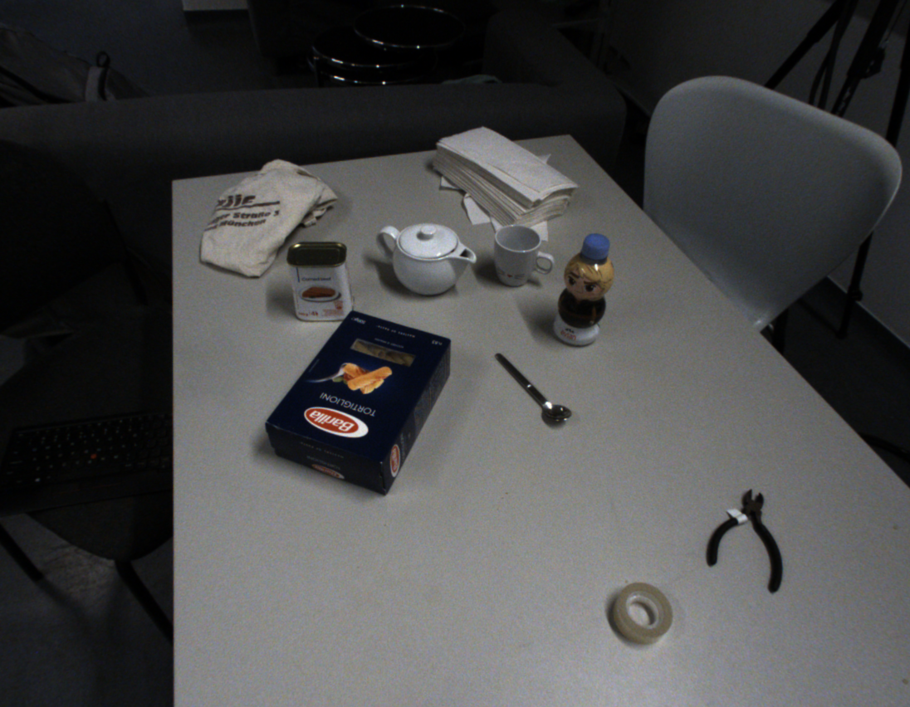
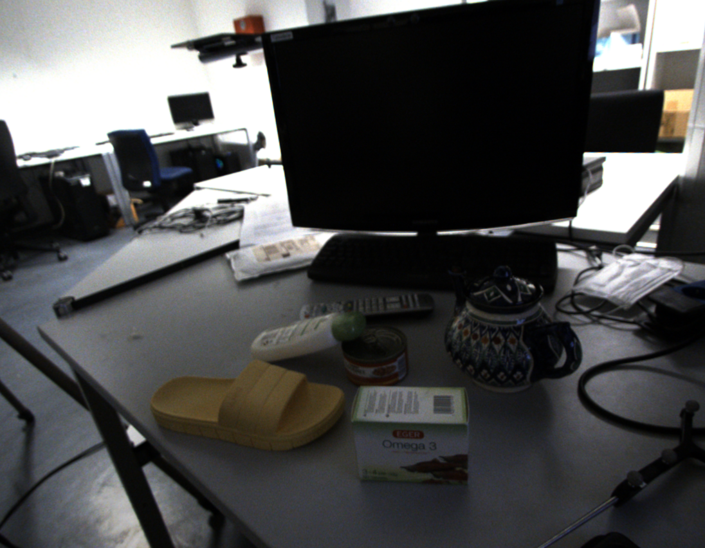
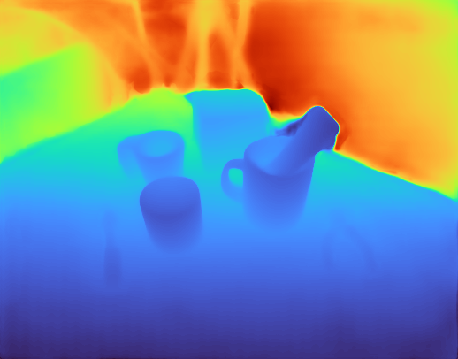
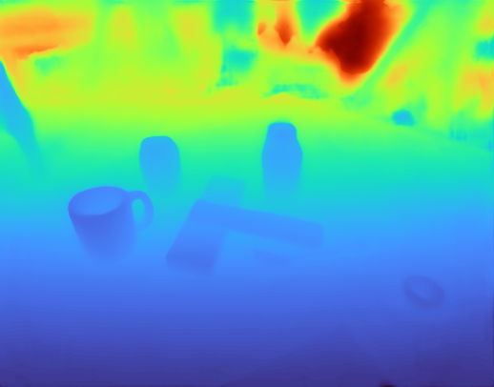
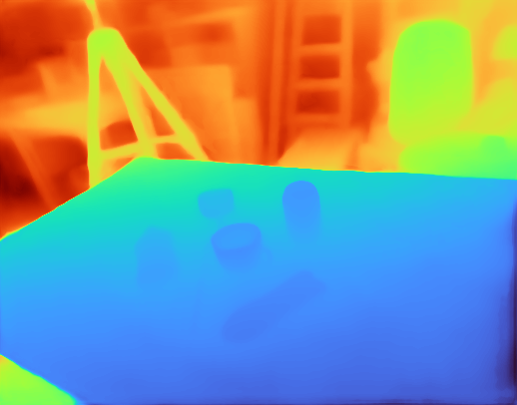
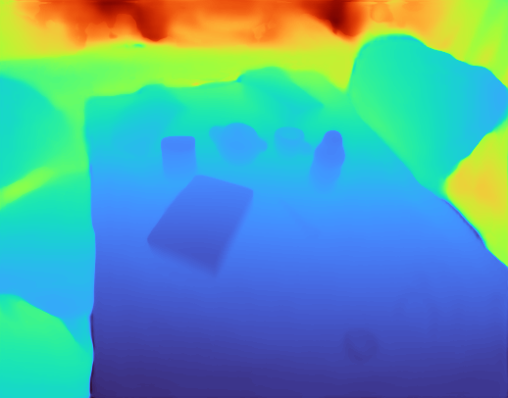
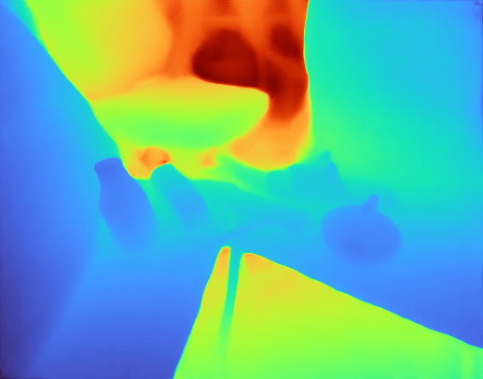
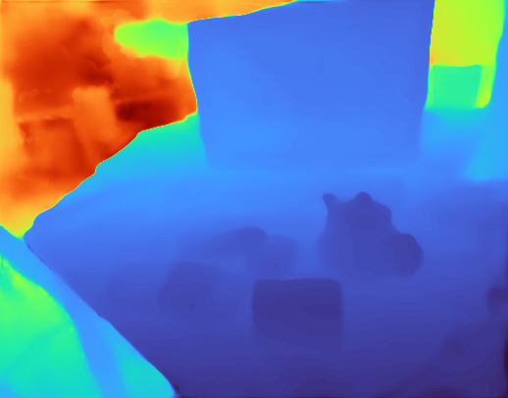
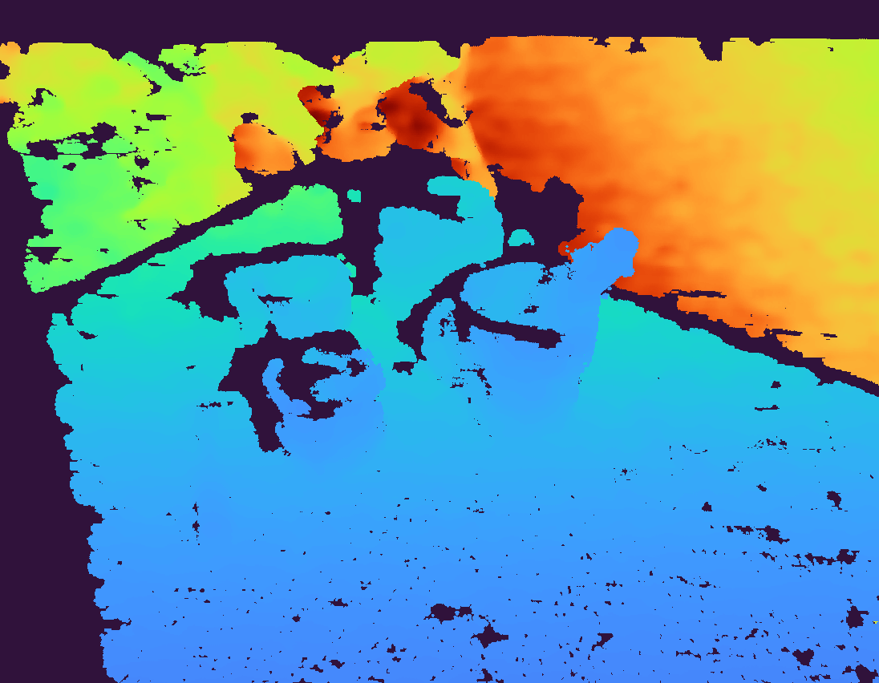
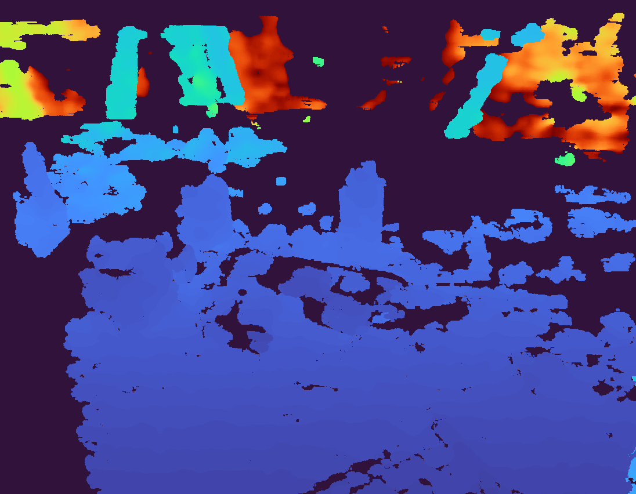
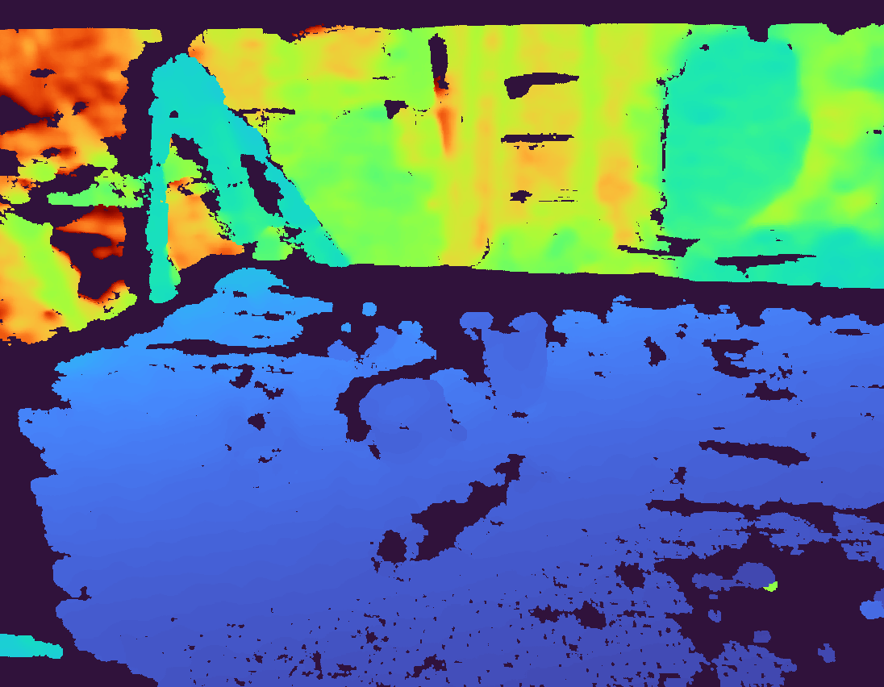
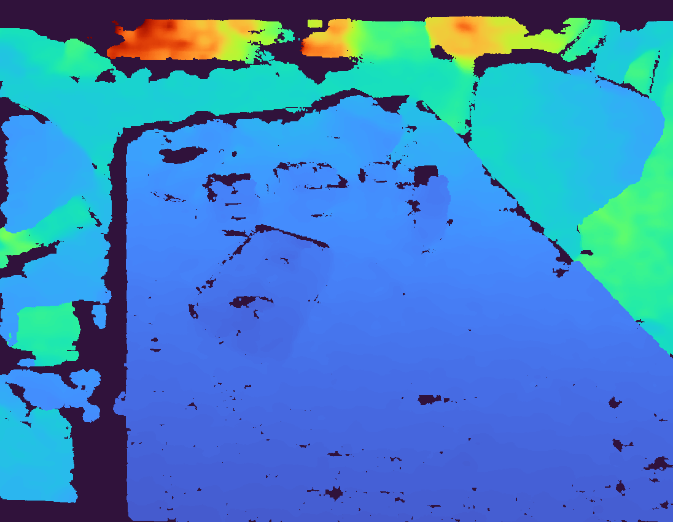
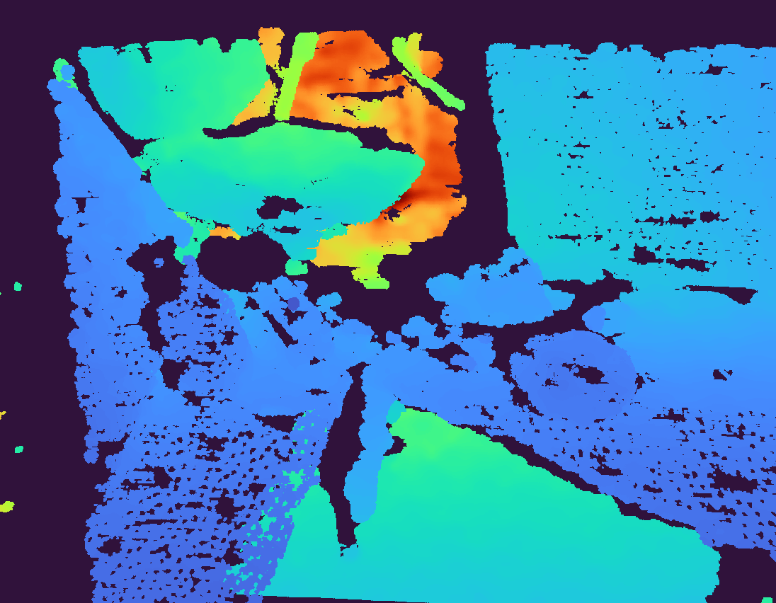
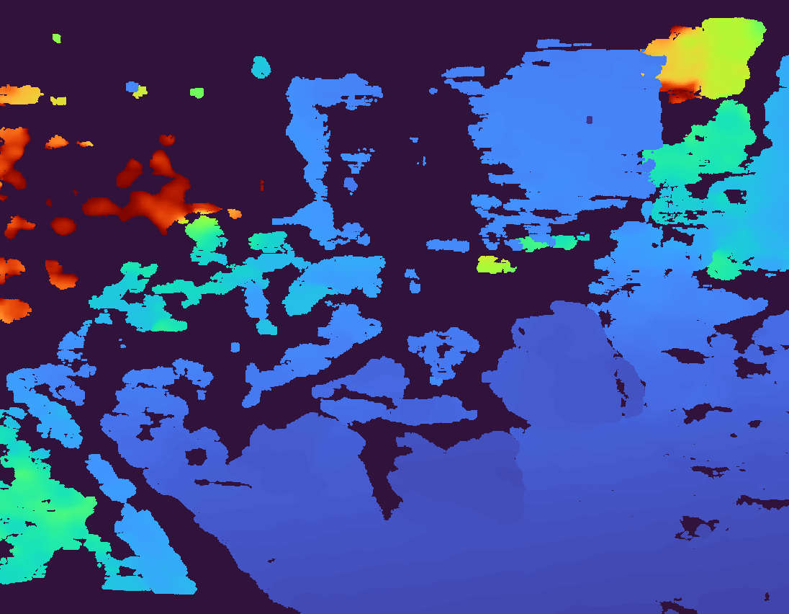
VGGT: Depth Estimation
Figure. Given housecat6D dataset, the first row are the target images, second row are the estimated depths by VGGT, and the third row are the ground truth depths.
Wang, Jianyuan, et al. "VGGT: Visual Geometry Grounded Transformer." Proceedings of the IEEE/CVF Conference on Computer Vision and Pattern Recognition, 2025. arXiv.org, arxiv.org/abs/2503.11651

Slide 20
3D Mesh Generation

Slide 21
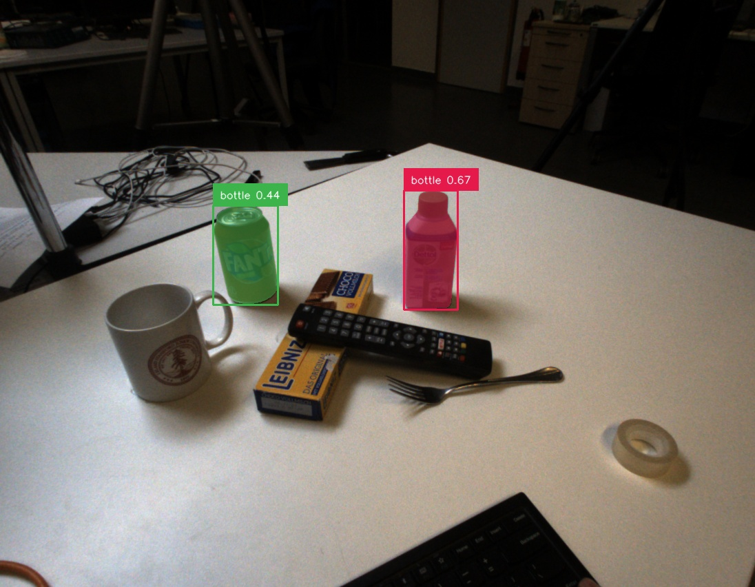
Segmentation Methods
Grounded-Sam-2: Grounding DINO + SAM2 (Pipeline)
We need unique description for this target in a scene.
We cannot use overly specific names. It would confuse Grounded-Sam-2’s segmentation.
Figure: Original Scene Input
Figure: Selection Result from Grounded-Sam-2
Ren, T., Liu, S., Zeng, A., Lin, J., Li, K., Cao, H., ... & Zhang, L. (2024). Grounded sam: Assembling open-world models for diverse visual tasks. arXiv preprint arXiv:2401.14159.
Ren, T., Jiang, Q., Liu, S., Zeng, Z., Liu, W., Gao, H., ... & Zhang, L. (2024). Grounding dino 1.5: Advance the" edge" of open-set object detection. arXiv preprint arXiv:2405.10300.
Ravi, N., Gabeur, V., Hu, Y. T., Hu, R., Ryali, C., Ma, T., ... & Feichtenhofer, C. (2024). Sam 2: Segment anything in images and videos. arXiv preprint arXiv:2408.00714.

Slide 22
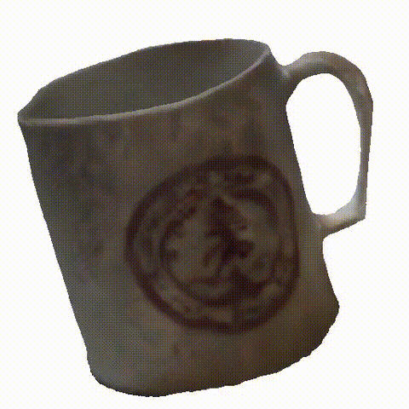
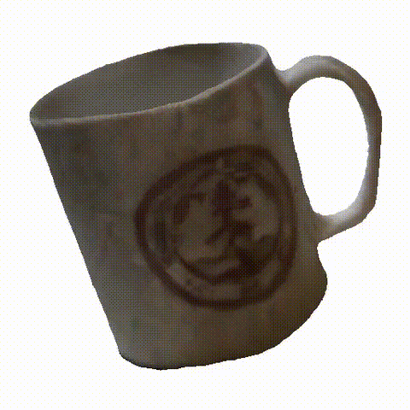

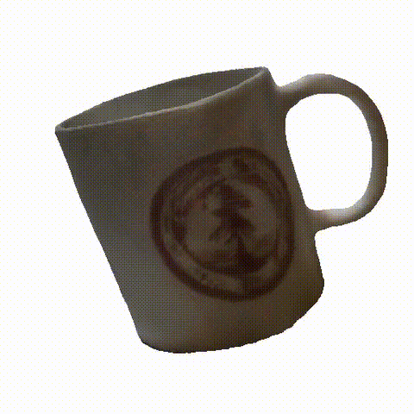
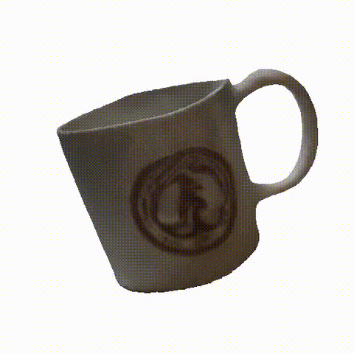
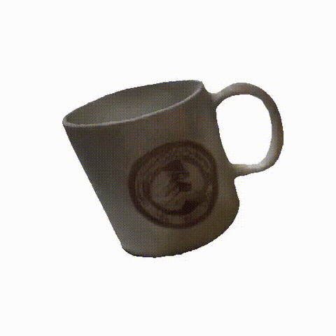
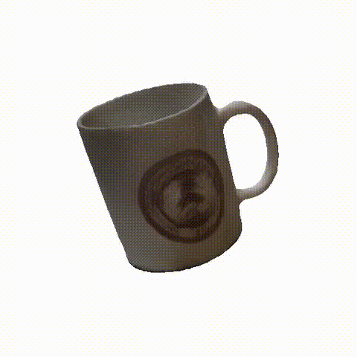
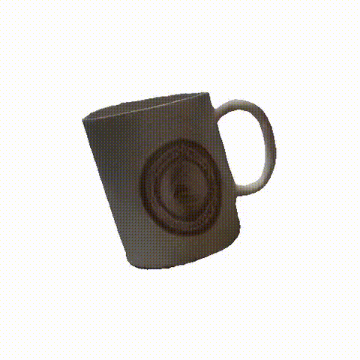
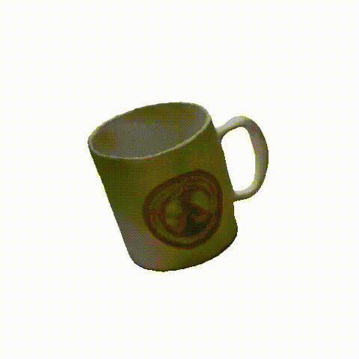
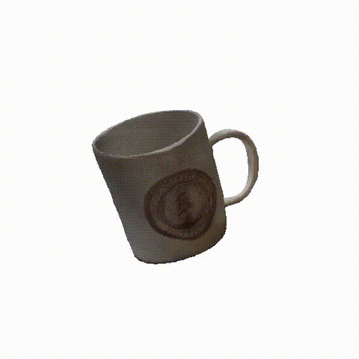
Preprocess methods
Tried different preprocess method: Center, Padding(0%-100%), Rembg
Figure: Imput images form padding 0% - 100%
0
10
20
30
40
Figure: Results form padding 0% - 100%
50
60
70
80
90

Slide 23
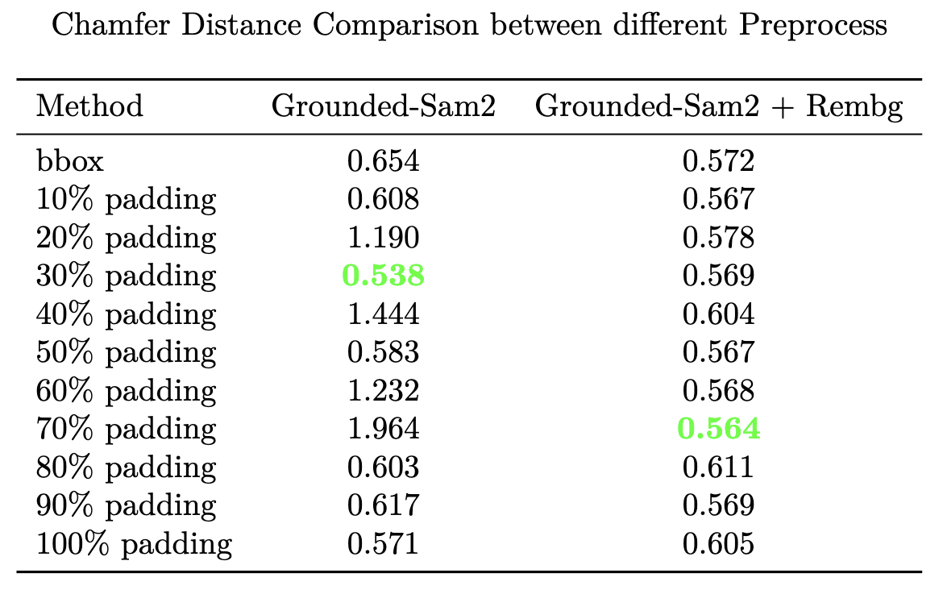
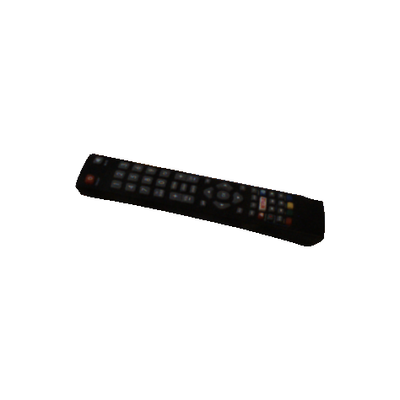
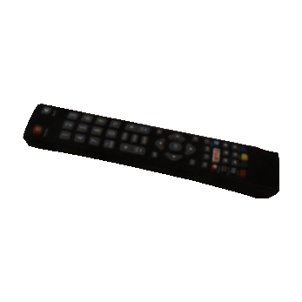
Preprocess methods
Centered + 30% padding has best average performance, while rembg provides more stable results
Figure: Center + 30% padding
Figure: Rembg-Tool
U^2-Net generation
Citation: https://github.com/danielgatis/rembg
Qin, X., Zhang, Z., Huang, C., Dehghan, M., Zaiane, O. R., & Jagersand, M. (2020). U2-Net: Going deeper with nested U-structure for salient object detection. Pattern recognition, 106, 107404.
So we choose: Center + 30% padding + Rembg-Tool,
padding size does not matter so much

Slide 24
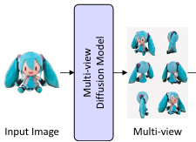
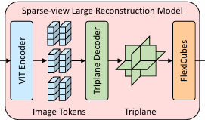
Generation models: Multiview Generation
Baseline: InstantMesh
fine tuned Zero123++
(on white background)
Reconstruction Model
Single RGB Image
Multiview RGB Images
3D Model
bottleneck
Figure . Outline of InstantMesh
Xu, J., Cheng, W., Gao, Y., Wang, X., Gao, S., & Shan, Y. (2024). Instantmesh: Efficient 3d mesh generation from a single image with sparse-view large reconstruction models. arXiv preprint arXiv:2404.07191.

Slide 25
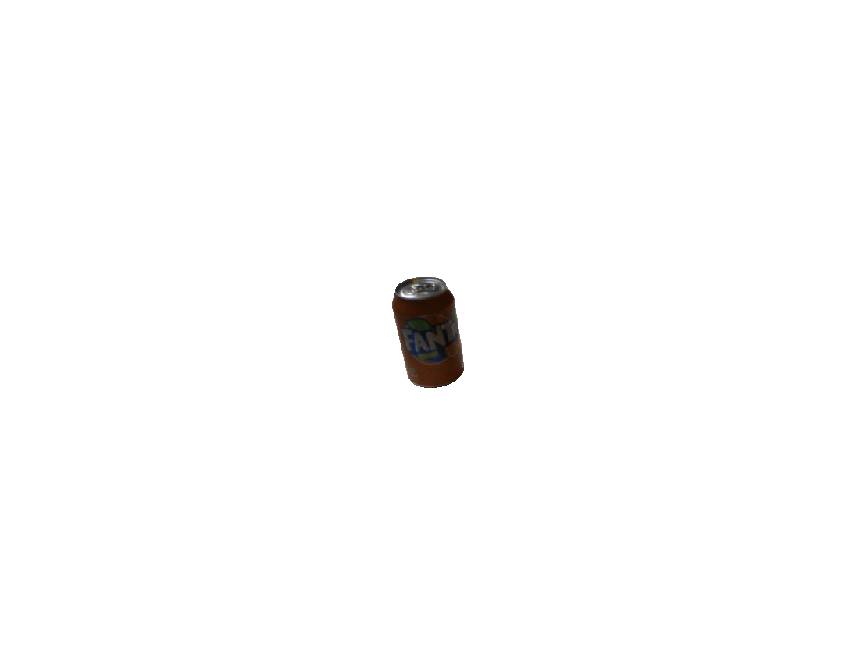
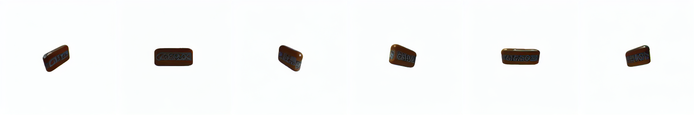
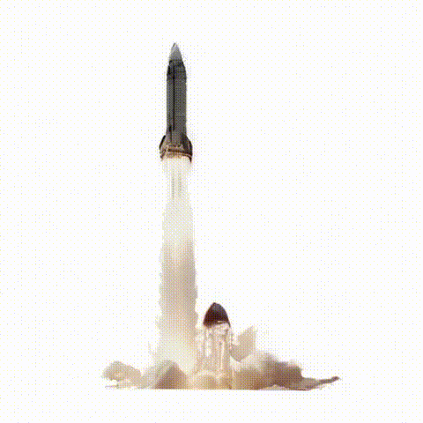
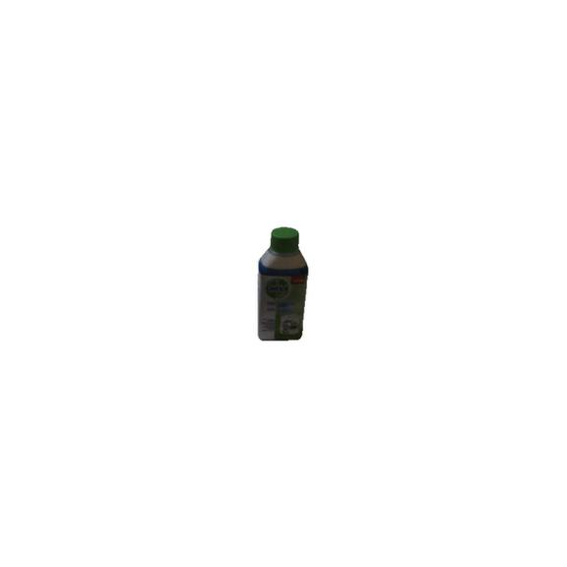
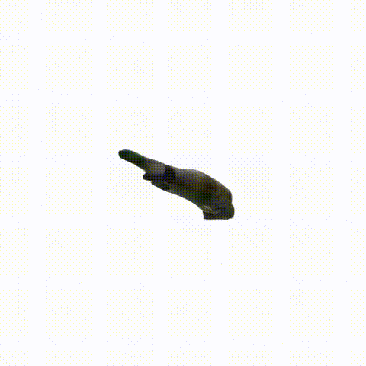
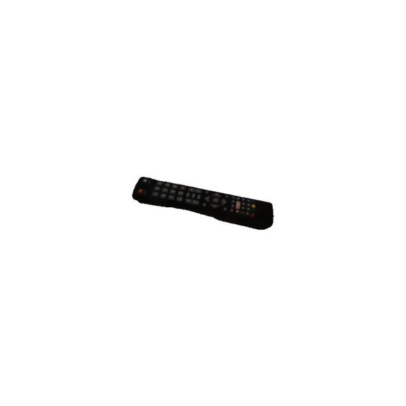
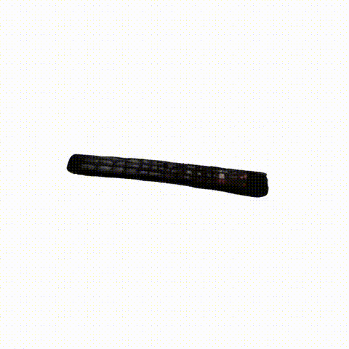





Generation models: Multiview Generation
EscherNet
Kong, X., Liu, S., Lyu, X., Taher, M., Qi, X., & Davison, A. J. (2024). Eschernet: A generative model for scalable view synthesis. In Proceedings of the IEEE/CVF Conference on Computer Vision and Pattern Recognition (pp. 9503-9513).
SV3D (Video Generation)
Voleti, V., Yao, C. H., Boss, M., Letts, A., Pankratz, D., Tochilkin, D., ... & Jampani, V. (2024, September). Sv3d: Novel multi-view synthesis and 3d generation from a single image using latent video diffusion. In European Conference on Computer Vision (pp. 439-457). Cham: Springer Nature Switzerland.
MVGenMaster (Video Generation)
Cao, C., Yu, C., Liu, S., Wang, F., Xue, X., & Fu, Y. (2025). MVGenMaster: Scaling Multi-View Generation from Any Image via 3D Priors Enhanced Diffusion Model. In Proceedings of the Computer Vision and Pattern Recognition Conference (pp. 6045-6056).
Figure:
Line1: Eschernet result (image, result)
Line2: SV3D result (image, result)
Line2: MVGenMaster result (image, result)

Slide 26











Generation models: Multiview Generation
Figure:
Line1: input image
Line2: Era3D result
Line3: InstantMesh result
Era3D
InstantMesh
Best Case
Li, P., Liu, Y., Long, X., Zhang, F., Lin, C., Li, M., ... & Guo, Y. (2024). Era3d: High-resolution multiview diffusion using efficient row-wise attention. Advances in Neural Information Processing Systems, 37, 55975-56000.
Xu, J., Cheng, W., Gao, Y., Wang, X., Gao, S., & Shan, Y. (2024). Instantmesh: Efficient 3d mesh generation from a single image with sparse-view large reconstruction models. arXiv preprint arXiv:2404.07191.

Slide 27
Generation models: Multiview Generation
Conclusion:
Results are not better than InstantMesh.
Comment:
Multiview generation models are outdated.
Before 2025, multiview generation is necessary for 3d mesh generation
But in 2025, multiview is no longer necessary as the separate part of image-to-3d model.
Current Model are tend to adopt an end-to-end design.

Slide 28


Generation models
MIDI-3D
Image -> 3D Instances
Figure . Outline of Midi-3D
Huang, Z., Guo, Y. C., An, X., Yang, Y., Li, Y., Zou, Z. X., ... & Sheng, L. (2025). Midi: Multi-instance diffusion for single image to 3d scene generation. In Proceedings of the Computer Vision and Pattern Recognition Conference (pp. 23646-23657).
Hi3DGen
Image -> normal map -> geometry
Ye, C., Wu, Y., Lu, Z., Chang, J., Guo, X., Zhou, J., ... & Han, X. (2025). Hi3dgen: High-fidelity 3d geometry generation from images via normal bridging. arXiv preprint arXiv:2503.22236, 3, 2.
Figure . Outline of Hi3DGen

Slide 29


Generation models
Hunyuan3D 2.5
Image -> 3D mesh
Image + 3D mesh -> Texture
TRELLIS
Train: 3D model -> latent space -> 3D model
Inference: latent value + image -> 3D model
Figure . Outline of TRELLIS
Lai, Z., Zhao, Y., Liu, H., Zhao, Z., Lin, Q., Shi, H., ... & Guo, C. (2025). Hunyuan3D 2.5: Towards High-Fidelity 3D Assets Generation with Ultimate Details. arXiv preprint arXiv:2506.16504.
Xiang, J., Lv, Z., Xu, S., Deng, Y., Wang, R., Zhang, B., ... & Yang, J. (2025). Structured 3d latents for scalable and versatile 3d generation. In Proceedings of the Computer Vision and Pattern Recognition Conference (pp. 21469-21480).
Figure . Outline of Hunyuan3D 2.5

Slide 30
Generation models: Image-to-3d Model
Tried different entire Generation Model:
New released model in 2025
CraftsMan, Hunyuan3D 2.5, Hi3dGen, TRELLIS, MIDI-3d.
Comments
InstantMesh and CraftsMan is traditional pipeline: image -> multiview -> 3d mesh
Hunyuan specifically designed for a best high-quality material generation.
Hi3dGen specifically designed for a best high-quality geometry generation.
TRELLES and MIDI-3D are used to generate the whole scene.
Xu, J., Cheng, W., Gao, Y., Wang, X., Gao, S., & Shan, Y. (2024). Instantmesh: Efficient 3d mesh generation from a single image with sparse-view large reconstruction models. arXiv preprint arXiv:2404.07191.
Li, W., Liu, J., Yan, H., Chen, R., Liang, Y., Chen, X., ... & Long, X. (2025). CraftsMan3D: High-fidelity Mesh Generation with 3D Native Diffusion and Interactive Geometry Refiner. In Proceedings of the Computer Vision and Pattern Recognition Conference (pp. 5307-5317).
Lai, Z., Zhao, Y., Liu, H., Zhao, Z., Lin, Q., Shi, H., ... & Guo, C. (2025). Hunyuan3D 2.5: Towards High-Fidelity 3D Assets Generation with Ultimate Details. arXiv preprint arXiv:2506.16504.
Ye, C., Wu, Y., Lu, Z., Chang, J., Guo, X., Zhou, J., ... & Han, X. (2025). Hi3dgen: High-fidelity 3d geometry generation from images via normal bridging. arXiv preprint arXiv:2503.22236, 3, 2.
Xiang, J., Lv, Z., Xu, S., Deng, Y., Wang, R., Zhang, B., ... & Yang, J. (2025). Structured 3d latents for scalable and versatile 3d generation. In Proceedings of the Computer Vision and Pattern Recognition Conference (pp. 21469-21480).
Huang, Z., Guo, Y. C., An, X., Yang, Y., Li, Y., Zou, Z. X., ... & Sheng, L. (2025). Midi: Multi-instance diffusion for single image to 3d scene generation. In Proceedings of the Computer Vision and Pattern Recognition Conference (pp. 23646-23657).

Slide 31










Generation models: InstantMesh (Baseline)
Xu, J., Cheng, W., Gao, Y., Wang, X., Gao, S., & Shan, Y. (2024). Instantmesh: Efficient 3d mesh generation from a single image with sparse-view large reconstruction models. arXiv preprint arXiv:2404.07191.
Figure:
Line1: input image
Line2: InstantMesh result

Slide 32





Generation models: CraftsMan
Li, W., Liu, J., Yan, H., Chen, R., Liang, Y., Chen, X., ... & Long, X. (2025). CraftsMan3D: High-fidelity Mesh Generation with 3D Native Diffusion and Interactive Geometry Refiner. In Proceedings of the Computer Vision and Pattern Recognition Conference (pp. 5307-5317).
Figure:
Line1: input image
Line2: CraftsMan result

Slide 33





Generation models: Hunyuan3D 2.5
Lai, Z., Zhao, Y., Liu, H., Zhao, Z., Lin, Q., Shi, H., ... & Guo, C. (2025). Hunyuan3D 2.5: Towards High-Fidelity 3D Assets Generation with Ultimate Details. arXiv preprint arXiv:2506.16504.
Figure:
Line1: input image
Line2: Hunyuan3D result

Slide 34





Generation models: Hi3DGen
Ye, C., Wu, Y., Lu, Z., Chang, J., Guo, X., Zhou, J., ... & Han, X. (2025). Hi3dgen: High-fidelity 3d geometry generation from images via normal bridging. arXiv preprint arXiv:2503.22236, 3, 2.
Figure:
Line1: input image
Line2: Hi3DGen result

Slide 35





Generation models: TRELLIS
Xiang, J., Lv, Z., Xu, S., Deng, Y., Wang, R., Zhang, B., ... & Yang, J. (2025). Structured 3d latents for scalable and versatile 3d generation. In Proceedings of the Computer Vision and Pattern Recognition Conference (pp. 21469-21480).
Figure:
Line1: input image
Line2: TRELLIS result

Slide 36





Generation models: MIDI-3D
Huang, Z., Guo, Y. C., An, X., Yang, Y., Li, Y., Zou, Z. X., ... & Sheng, L. (2025). Midi: Multi-instance diffusion for single image to 3d scene generation. In Proceedings of the Computer Vision and Pattern Recognition Conference (pp. 23646-23657).
Figure:
Line1: input image
Line2: MIDI-3D result

Slide 37
Evaluation

Slide 38
Evaluation: overview
VGGT
Result
Mesh
a.method
b.Target selection
c.Result
Pose
a.method
b.Result

Slide 39

Evaluation: VGGT Depth
MAE – Mean Absolute Error
RMSE – Root Mean Squared Error
Table. MAE and RMSE errors of estimated depths comparing to the ground truth
Notes:
We evaluated VGGT across 10 indoor scenes using MAE and RMSE.
Default MAE: 0.33 m, RMSE: 0.45 m → Good for indoor scenarios.
After normalization, error drops to MAE: 0.18, RMSE: 0.39 → Very strong performance.
after normalization, it mostly evaluates the geometry.
Overall, VGGT produces reliable depth maps suitable for tasks like 3D reconstruction and pose estimation.

Slide 40

Evaluation: Method
Align
The generated mesh would have different pose than groundtruth mesh
and the evaluation make sense only when these meshes are in the same pose
Figure . Meshed before alignment, horizontal mesh is generated mesh, vertical mesh is groundtruth mesh

Slide 41



Evaluation: Method
Align
We can end up have a aligned mesh for reconstruction evaluation
Figure . aligned mesh

Slide 42

Evaluation: Method
Chamfer distance
chamfer distance is a metric to compare the distance between two pointclouds, the lower the value is, the recosntruction performance is better
chamfer_distance = 0.56
Figure . chamfer_distance example

Slide 43
Evaluation: Target selection
Housecat6D
In Housecat6D, we choose the 000000.png in scene01-scene10
Figure . 000000.png in scene01
Jung, HyunJun and Wu, Shun-Cheng and Ruhkamp, Patrick and Zhai, Guangyao and Schieber, Hannah and Rizzoli, Giulia and Wang, Pengyuan and Zhao, Hongcheng and Garattoni, Lorenzo
and Meier, Sven and Roth, Daniel and Navab, Nassir and Busam, Benjamin. HouseCat6D-A Large-Scale Multi-Modal Category Level 6D Object Perception Dataset with Household Objects
in Realistic Scenarios (CVPR2024)

Slide 44


Evaluation: Target selection
Baseline experiment
This is the chamfer distance for each scene and object by using the 3D generation method in Any6D
Table. average chamfer distance in each object
Table. average chamfer distance in each scene

Slide 45



Evaluation: Target selection
Baseline experiment
Low chamfer distance example
Figure.nicely generated remote from scene3

Slide 46



Evaluation: Target selection
Baseline experiment
High chamfer distance example
Figure.poorly generated glass from scene5

Slide 47
Evaluation: 3D generation model
Experiment on different models
same
Preprocessed
image
different generation model
compare
Zibo Zhao, Zeqiang Lai, Qingxiang Lin, Yunfei Zhao, Haolin Liu, Shuhui Yang, Yifei Feng, Mingxin Yang, Sheng Zhang, Xianghui Yang, Huiwen Shi, Sicong Liu, Junta Wu, Yihang Lian, Fan Yang, Ruining Tang, Zebin He, Xinzhou Wang, Jian Liu, Xuhui Zuo, Zhuo Chen, Biwen Lei, Haohan Weng, Jing Xu, Yiling Zhu, Xinhai Liu, Lixin Xu, Changrong Hu, Shaoxiong Yang, Song Zhang, Yang Liu, Tianyu Huang, Lifu Wang, Jihong Zhang, Meng Chen, Liang Dong, Yiwen Jia, Yulin Cai, Jiaao Yu, Yixuan Tang, Hao Zhang, Zheng Ye, Peng He, Runzhou Wu, Chao Zhang, Yonghao Tan, Jie Xiao, Yangyu Tao, Jianchen Zhu, Jinbao Xue, Kai Liu, Chongqing Zhao, Xinming Wu, Zhichao Hu, Lei Qin, Jianbing Peng, Zhan Li, Minghui Chen, Xipeng Zhang, Lin Niu, Paige Wang, Yingkai Wang, Haozhao Kuang, Zhongyi Fan, Xu Zheng, Weihao Zhuang, YingPing He, Tian Liu, Yong Yang, Di Wang, Yuhong Liu, Jie Jiang, Jingwei Huang, Chunchao Guo. Hunyuan3D 2.0: Scaling Diffusion Models for High Resolution Textured 3D Assets Generation, arXiv:2501.12202

Slide 48

Evaluation: 3D generation model
Experiment on different models
Table . Comparison between generation methods
Xu, Jiale and Cheng, Weihao and Gao, Yiming and Wang, Xintao and Gao, Shenghua and Shan, Ying. InstantMesh: Efficient 3D Mesh Generation from a Single Image with Sparse-view Large Reconstruction Models,arXiv preprint arXiv:2404.07191,2024
Zibo Zhao, Zeqiang Lai, Qingxiang Lin, Yunfei Zhao, Haolin Liu, Shuhui Yang, Yifei Feng, Mingxin Yang, Sheng Zhang, Xianghui Yang, Huiwen Shi, Sicong Liu, Junta Wu, Yihang Lian, Fan Yang, Ruining Tang, Zebin He, Xinzhou Wang, Jian Liu, Xuhui Zuo, Zhuo Chen, Biwen Lei, Haohan Weng, Jing Xu, Yiling Zhu, Xinhai Liu, Lixin Xu, Changrong Hu, Shaoxiong Yang, Song Zhang, Yang Liu, Tianyu Huang, Lifu Wang, Jihong Zhang, Meng Chen, Liang Dong, Yiwen Jia, Yulin Cai, Jiaao Yu, Yixuan Tang, Hao Zhang, Zheng Ye, Peng He, Runzhou Wu, Chao Zhang, Yonghao Tan, Jie Xiao, Yangyu Tao, Jianchen Zhu, Jinbao Xue, Kai Liu, Chongqing Zhao, Xinming Wu, Zhichao Hu, Lei Qin, Jianbing Peng, Zhan Li, Minghui Chen, Xipeng Zhang, Lin Niu, Paige Wang, Yingkai Wang, Haozhao Kuang, Zhongyi Fan, Xu Zheng, Weihao Zhuang, YingPing He, Tian Liu, Yong Yang, Di Wang, Yuhong Liu, Jie Jiang, Jingwei Huang, Chunchao Guo. Hunyuan3D 2.0: Scaling Diffusion Models for High Resolution Textured 3D Assets Generation, arXiv:2501.12202
Xiang, Jianfeng and Lv, Zelong and Xu, Sicheng and Deng, Yu and Wang, Ruicheng and Zhang, Bowen and Chen, Dong and Tong, Xin and Yang, Jiaolong.Structured 3D Latents for Scalable and Versatile 3D Generation,arXiv preprint arXiv:2412.01506
Weiyu Li, Jiarui Liu, Hongyu Yan, Rui Chen, Yixun Liang, Xuelin Chen, Ping Tan, Xiaoxiao Long. CraftsMan3D: High-fidelity Mesh Generation with 3D Native Generation and Interactive Geometry Refiner, arXiv:2405.14979
Huang, Zehuan and Guo, Yuan-Chen and An, Xingqiao and Yang, Yunhan and Li, Yangguang and Zou, Zi-Xin and Liang, Ding and Liu, Xihui and Cao, Yan-Pei and Sheng, Lu.Midi: Multi-instance diffusion for single image to 3d scene generation.Proceedings of the Computer Vision and Pattern Recognition Conference.2025
Ye, Chongjie and Wu, Yushuang and Lu, Ziteng and Chang, Jiahao and Guo, Xiaoyang and Zhou, Jiaqing and Zhao, Hao and Han, Xiaoguang.Hi3DGen: High-fidelity 3D Geometry Generation from Images via Normal Bridging.arXiv preprint arXiv:2503.22236.2025
Notes:
the goal here is to choose good model for input comparison

Slide 49
Evaluation: 3D generation model
Experiment on different preprocessed image
different preprocessed image
Same
generation model
compare
Table . Comparison between preprocessed image

Slide 50

Evaluation: 3D generation model
Experiment on different preprocessed image
Table . Comparison between preprocessed image
Zibo Zhao, Zeqiang Lai, Qingxiang Lin, Yunfei Zhao, Haolin Liu, Shuhui Yang, Yifei Feng, Mingxin Yang, Sheng Zhang, Xianghui Yang, Huiwen Shi, Sicong Liu, Junta Wu, Yihang Lian, Fan Yang, Ruining Tang, Zebin He, Xinzhou Wang, Jian Liu, Xuhui Zuo, Zhuo Chen, Biwen Lei, Haohan Weng, Jing Xu, Yiling Zhu, Xinhai Liu, Lixin Xu, Changrong Hu, Shaoxiong Yang, Song Zhang, Yang Liu, Tianyu Huang, Lifu Wang, Jihong Zhang, Meng Chen, Liang Dong, Yiwen Jia, Yulin Cai, Jiaao Yu, Yixuan Tang, Hao Zhang, Zheng Ye, Peng He, Runzhou Wu, Chao Zhang, Yonghao Tan, Jie Xiao, Yangyu Tao, Jianchen Zhu, Jinbao Xue, Kai Liu, Chongqing Zhao, Xinming Wu, Zhichao Hu, Lei Qin, Jianbing Peng, Zhan Li, Minghui Chen, Xipeng Zhang, Lin Niu, Paige Wang, Yingkai Wang, Haozhao Kuang, Zhongyi Fan, Xu Zheng, Weihao Zhuang, YingPing He, Tian Liu, Yong Yang, Di Wang, Yuhong Liu, Jie Jiang, Jingwei Huang, Chunchao Guo. Hunyuan3D 2.0: Scaling Diffusion Models for High Resolution Textured 3D Assets Generation, arXiv:2501.12202

Slide 51

Evaluation: 3D generation model
Experiment on different preprocessed image
Table . Comparison between preprocessed image
Xiang, Jianfeng and Lv, Zelong and Xu, Sicheng and Deng, Yu and Wang, Ruicheng and Zhang, Bowen and Chen, Dong and Tong, Xin and Yang, Jiaolong.Structured 3D Latents for Scalable and Versatile 3D Generation,arXiv preprint arXiv:2412.01506

Slide 52

Evaluation: Pose evaluation
What is relative pose
Figure.view anchor image
Figure.view target image

Slide 53
Evaluation: Pose evaluation
ADD,ADD-S,R_error,T_error
ADD (Average Distance of Model Points)
Calculates the mean distance between each point on a 3D model transformed by the estimated pose and the corresponding point transformed by the ground truth pose.
ADD-S (Average Distance of Model Points - Symmetric)
Designed for symmetric or partially symmetric objects.
For each model point under the estimated pose, ADD-S measures the distance to the closest point on the model under the ground truth pose, using a nearest neighbor search.
R_error,T_error
R_error is the angular difference for predicted pose, measurement in degrees here
T_error is the euclidean distance for predicted pose,measuremen in centimeter here

Slide 54

Evaluation: Pose evaluation
Table . Any6D pose evaluation result on housecat6d

Slide 55
Conclusion
Complete Pipeline Construction We built a full pipeline from targets in RGB images to 3D mesh reconstruction and finally to 6D pose estimation.
Comprehensive Research at Each Stage
Depth prediction
Extract the target from img and do mesh generation
From RGBD and 3D mesh to 6D pose estimation

Slide 56
Conclusion
Extensive Module Testing and Comparison
Depth generation
VGGT got good result for depth prediction
Mesh generation
Non-texture mesh can has the same performance as texture mesh
The new end-to-end generation model outperforms the old methods
Limitations
Fully test all modules and do comprehensive evaluation.
Current Any6D will give slightly different pose, which seems to be local minimum for the right pose.

Slide 57
What’s Next?

Slide 58


What’s Next:
Current Problem:
The error rate of Any6D is too high. The output of Any6D is hard to control.
Any6D uses a NN for scoring, but the score does not necessarily increase as the predicted pose gets closer to the ground truth.
sometimes assigns the highest score to a clearly incorrect result.

Slide 59

What’s Next: Overview
The pose from Any6D is not as good as they claimed:
Research Plan:
get a better pose estimation

Slide 60
Thanks!

Slide 61
Appendix

Slide 62

Evaluation: Method
Align
In any6d, the same input for anchor and target image can help align the mesh and calculate the chamfer distance
Figure . The alignment procedure in Any6D
Lee, Taeyeop and Wen, Bowen and Kang, Minjun and Kang, Gyuree and Kweon, In So and Yoon, Kuk-Jin. {Any6D}: Model-free 6D Pose Estimation of Novel Objects, (CVPR2025)

Slide 63


Evaluation: Method
Align
Several size and pose of mesh would be created and applied to generated mesh, then be scored with transformer.
Figure . Left image is the score for different size, right image is score for different pose

Slide 64
Evaluation: Method
Align
We change the resized from non-uniform scale in xyz, to an uniform scale. So that we can have an idea how good the structure of generated mesh is
adjust to resize evenly
Figure . The adjusted even_resized in Any6D
Lee, Taeyeop and Wen, Bowen and Kang, Minjun and Kang, Gyuree and Kweon, In So and Yoon, Kuk-Jin. {Any6D}: Model-free 6D Pose Estimation of Novel Objects, (CVPR2025)

